Slide 1

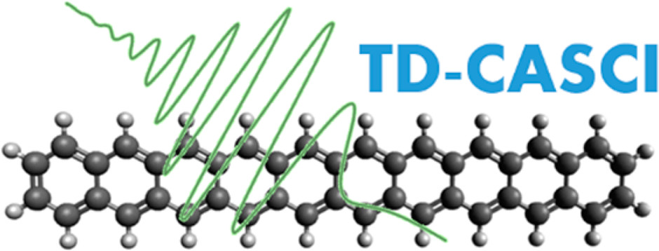
Modeling Nonadiabatic Dynamics
on Many Electronic States
Michael P. Esch and Benjamin G. Levine
Stony Brook University IACS and Chemistry Departments

Slide 2
Decoherence Corrected Ehrenfest Dynamics using Approximate Electronic States
Efficient propagation of classical degrees of freedom on the Ehrenfest potential energy surface (PES)
Refines trajectory dynamics with properties of the approximate electronic states to avoid the qualitative error of mean-field PES propagation of standard Ehrenfest
Refinements from the decoherence correction are applied without computing the full electronic eigenspectrum!

Slide 4
Decoherence Corrected Ehrenfest Dynamics using Approximate Electronic States
Efficient propagation of classical degrees of freedom on the Ehrenfest potential energy surface (PES)
Refines trajectory dynamics with properties of the approximate electronic states to avoid the qualitative error of mean-field PES propagation of standard Ehrenfest
Refinements from the decoherence correction are applied without computing the full electronic eigenspectrum!
Can be applied to systems where computing the full eigenspectrum would cause dynamics simulations to become intractable!

Slide 5
Correcting Dynamics for Electronic Coherence Loss
B. J. Schwartz and P. J. Rossky, J. Chem. Phys. 101, (1994) 6902.
E. R. Bittner and P. J. Rossky, J. Chem. Phys. 103, (1995) 8130.
B. J. Schwartz, E. R. Bittner, O. V. Prezhdo, P. J. Rossky The Journal of Chemical Physics 104 (1996) 5942.
O. V. Prezhdo and P. J. Rossky, J. Chem. Phys. 107 (1997) 825.
M. Thachuk, M. Y. Ivanov, and D. M. Wardlaw, The Journal of Chemical Physics 109 (1998) 5747.
J.-Y. Fang, and S. Hammes-Schiffer, The Journal of Physical Chemistry A 103 (1999) 9399.
M. Ben-Nun, J. Quenneville, and T. J. Martínez, The Journal of Physical Chemistry A 104 (2000) 5161.
M. D. Hack and D. G. Truhlar, J. Chem. Phys. 114 (2001) 9305.
C. Zhu, S. Nangia, A. W. Jasper, D. G. Truhlar, The Journal of Chemical Physics 121 (2004) 7658.
M. J. Bedard-Hearn, R. E. Larsen, and B. J. Schwartz, The Journal of Chemical Physics 123 (2005) 234106.
G. Granucci, and M. Persico, The Journal of Chemical Physics 126 (2007) 134114.
G. Granucci, M. Persico, and A. Zoccante, J. Chem. Phys. 133, 134111 (2010).
H. M. Jaeger, S. Fischer, and O. V. Prezhdo, The Journal of Chemical Physics 137 (2012) 22A545.
B. R. Landry, and J. E. Subotnik, The Journal of Chemical Physics 137 (2012) 22A513.
T. Nelson, S. Fernandez-Alberti, A. E. Roitberg, and S. Tretiak, J. Chem. Phys. 138(22), (2013) 224111.
D. V. Makhov, W. J. Glover, T. J. Martinez, and D. V. Shalashilin, The Journal of Chemical Physics 141 (2014) 054110.
D. V. Makhov, T. J. Martinez, and D. V. Shalashilin, Faraday Discuss. 194 (2016) 81.
51J. E. Subotnik, A. Jain, B. Landry, A. Petit, W. Ouyang, and N. Bellonzi, Annu. Rev. Phys. Chem. 67, (2016) 387.
L. J. Wang, A. Akimov, and O. V. Prezhdo, J. Phys. Chem. Lett. 7, (2016) 2100.
V. M. Freixas, S. Fernandez-Alberti, D. V. Makhov, S. Tretiak, and D. Shalashilin, Phys. Chem. Chem. Phys. 20 (2018) 17762.
D. A. Fedorov, and B. G. Levine, The Journal of Physical Chemistry Letters 10 (2019) 4542.
P. Nijjar, J. Jankowska, and O. V. Prezhdo, J. Chem. Phys. 150(20), (2019) 204124.

Slide 6
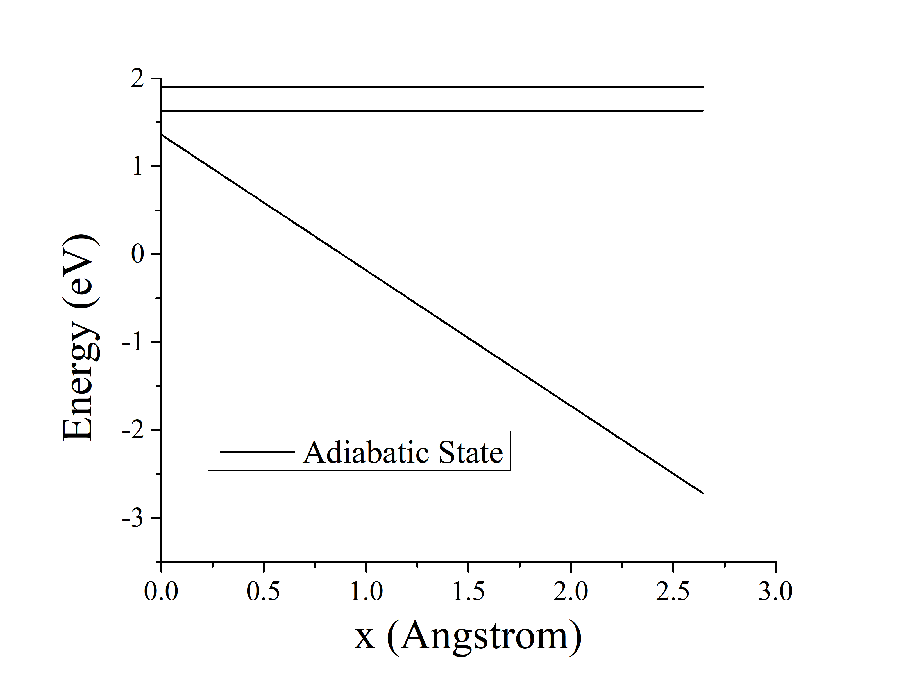
Collapse ‘to a block’ (TAB) corrected Ehrenfest Dynamics
M. P. Esch, and B. G. Levine, The Journal of Chemical Physics 152 (2020) 234105.

Slide 7
TAB wave function collapse procedure inputs
The trajectory density matrix generated from the Ehrenfest wave function
The state-pairwise decoherence times
The adiabatic electronic states
B. J. Schwartz et al., The Journal of Chemical Physics 104 (1996) 5942.

Slide 8
What to use instead of the complete adiabatic electronic basis?
Will generate a reduced rank approximate adiabatic basis using the history of the time-dependent Ehrenfest electronic wave function c(t)
Contains information of the dominant electronic states in the dynamics
Calculated at every electronic time step, so no additional computation is required to obtain it
Electronic time steps
Classical time step

Slide 9
What to use instead of the complete adiabatic electronic basis?
Will generate a reduced rank approximate adiabatic basis using the history of the time-dependent Ehrenfest electronic wave function c(t)
Contains information of the dominant electronic states in the dynamics
Calculated at every electronic time step, so no additional computation is required to obtain it
For those familiar with recent Levine group developments…
D. A. Fedorov, and B. G. Levine, The Journal of Physical Chemistry Letters 10 (2019) 4542.

Slide 10
Basis reduction using time history of the electronic wave function
Split the wave function into its real and imaginary parts at electronic time steps

Slide 11
Basis reduction using time history of the electronic wave function
Split the wave function into its real and imaginary parts at electronic time steps
Store the most recent N time steps in an array X

Slide 12
Basis reduction using time history of the electronic wave function
transformation matrix into the orthogonalized basis

Slide 13
Basis reduction using time history of the electronic wave function

Slide 14
Basis reduction using time history of the electronic wave function
M. P. Esch, and B. G. Levine, The Journal of Chemical Physics 153 (2020) 114104.

Slide 15
TAB-DMS Inputs (TAB using an approximate electronic basis)
The trajectory density matrix generated from the Ehrenfest wave function
The state-pairwise decoherence times
The approximate adiabatic electronic states

Slide 16
Model PESs for Probabilities of Transmission

Slide 18
Decoherence Parameter

Slide 20
Decoherence Parameter

Slide 21
Conclusions
We have demonstrated the history of the time-dependent Ehrenfest wave function can be used to generate a small approximate electronic basis that can be used by compatible decoherence corrections to Ehrenfest dynamics
Using a modest fraction of the total number of real electronic states TAB-DMS produces results in statistical agreement to TAB
Well parameterized TAB and TAB-DMS ensembles reasonably reproduce fully quantum mechanical probabilities of transmission
Work is being done to improve the accuracy of intuitive parameter TAB ensembles, since the intuitive parameters can be reasonably approximated for real systems using the ground state harmonic vibrational wave function.

Slide 22





Acknowledgments
Dr. Benjamin G. Levine
Current Group Members: Andy Durden, Fangchun Liang, Caitlin Hetherington, Katy Humphries
Former Group Members: Yinan Shu, Garrett Meek, B. Scott Fales, Wei-tao Peng, Dmitry Fedorov, Brandon Child, Dylan Hardwick, Adam Hartley
The VISTA organizers and all of you!
For funding through grant CHE-1954519
For funding through
grant FA9550-17-1-0411

Slide 23
Collapse ‘to a block’ (TAB) corrected Ehrenfest Dynamics
M. P. Esch, and B. G. Levine, The Journal of Chemical Physics 152 (2020) 234105.

Slide 24
The Wave Function Collapse Algorithm
Compute
B. J. Schwartz et al., The Journal of Chemical Physics 104 (1996) 5942.
M. P. Esch, and B. G. Levine, The Journal of Chemical Physics 152 (2020) 234105.

Slide 25
The Wave Function Collapse Algorithm
Compute
Generate a set of density matrices, , such that
and

Slide 26
The Wave Function Collapse Algorithm
Compute
Generate a set of density matrices, , such that
and
examples:

Slide 27
The Wave Function Collapse Algorithm
Compute
Generate a set of density matrices, , such that
Generate a random number, γ, from the uniform distribution [0,1). If
and
Then

